Slide 1
AI applications in Finance
Lecture 5
Introduction to Neural Networks
03-Dec-2020
Indranil Dutta

Slide 2
Recap
Steps in learning and prediction through neural networks
Get and examine the dataset
Define the model
Fit the model
Evaluate the model
Predict from the model.
Preprocessing of data through
Transformation
Normalization

Slide 3
Fun Fact(s) :
5 trends to look forward in 2021
Role of AI and Machine learning in ‘Hyperautomation’
“Anything that can be automated should be automated.”
Acceleration in this trend due to the pandemic
Digital process automation and Intelligent process automation
Adaptive systems based on deep learning and other components.
The rise of AI Engineering
Become part of the main business process not isolated projects.
Use of AI in cybersecurity operations
Not only on digital platforms but also smart homes.
Use of AL with the internet of things
Increase efficiencies in industrial automation
Creation of external AI ethics boards
Question and challenge use of AI in applications.
Sourcehttps://www.crn.com/news/cloud/5-emerging-ai-and-machine-learning-trends-to-watch-in-2021

Slide 4
Agenda – Session 5
Go through examples of tools for creating networks
Code based
Stand alone application based
Platform based
Principles of Network Design
Case studies through Excel
Prediction of the Real Estate Price in Boston MA.

Slide 5
Course Roadmap

Slide 6
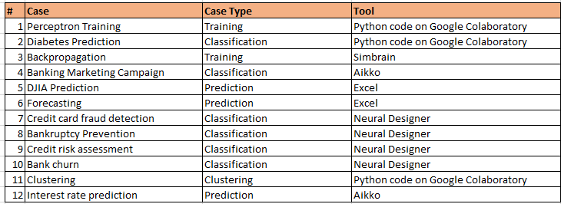
Cases & Tools

Slide 7
Principles of Network Design

Slide 8
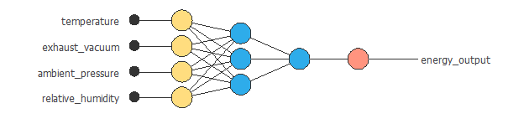
Design of a approximation network
Approximation network – predict a value
Scaling layer (range of -1 to 1) [yellow]
Perceptron layer [below]
Un-scaling layer / Bounding layer [red]
Source: https://www.neuraldesigner.com/learning/tutorials/neural-networks-applications#Approximation

Slide 9
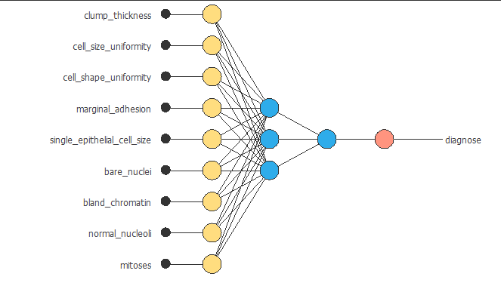
Design of a Classification network
Classification -> pattern recognition
Binary or multiple
Scaling layer (range of -1 to 1) [yellow]
Perceptron layer [below]
Probabilistic layer [red]
Binary -> Output = 0 if Output < Threshold or 1 otherwise.
Continuous -> Output = 0 if Output < 0
Output remains same if between 0 and 1
Output = 1 if Output > 1.
Competitive (multilabel) where number of output nodes > 1.
Output that has maximum value is set to 1, others are zero
Example : for 3 outputs -> classes/labels/groups -> [100][010][001]
Source: https://www.neuraldesigner.com/learning/tutorials/neural-networks-applications#Approximation, https://www.neuraldesigner.com/learning/tutorials/neural-network, https://www.neuraldesigner.com/learning/tutorials/neural-network#ProbabilisticLayer

Slide 10
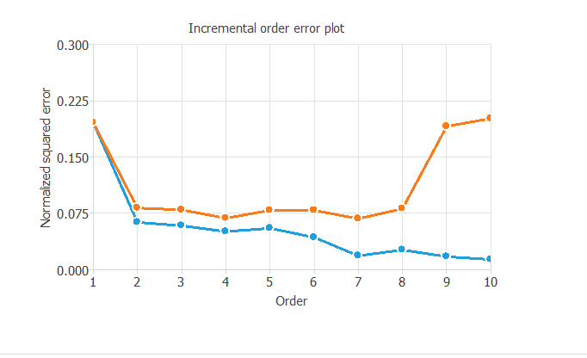
How do we design the network?
Guided by the concept of “Generalization” or adequate fit
Not overfitting or underfitting.
Best is when the following two errors are at minimum
Training error : ability to fit the data that is seen or known
Selection error : ability to generalize to unknown data.
Apply the learning to new set of data and the result is as close to expected as possible.
So -
Start with a default configuration
3 layers
No of nodes in input layer = no of inputs
No of hidden nodes = no of input nodes
No of output nodes dependent of type of problem
(regression/prediction, binary or multilabel classification)
Monitor the two errors
Change nodes/layers in the hidden layer
Source: https://www.neuraldesigner.com/learning/tutorials/model-selection

Slide 11
How do we choose the inputs to the network?
Specialized knowledge of the problem at hand.
Subset of inputs that provides the best generalization possible.
Start with finding the correlation between the inputs and output(s).
How closely the input/output pair is tied together.
Then an use either of two techniques
Growing inputs : start with inputs that have high correlation and add till selection error is increased.
Pruning inputs : start with all and keep removing those with smaller correlation till the minimum selection error is obtained
Use of genetic algorithms
Source: https://www.neuraldesigner.com/learning/tutorials/model-selection

Slide 12
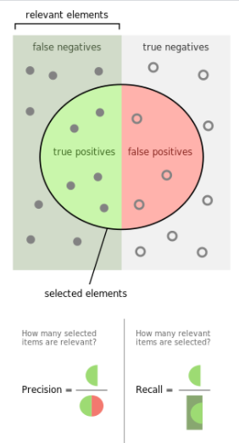
Two metrics to see network performance
Both are measures of ‘relevance’.
Precision
How many are relevant out of all that is retrieved.
Recall
Fraction of relevant objects that were retrieved.
Example:
Task -> identify dogs in a photograph of dogs (12) and
cats (10).
Results -> # of dogs identified = 8 , however 3 were cats
True positive: 5, True negative: 7, False positive: 3, False negative: 7
Precision : 5/8
Recall : 5/12
Source: https://en.wikipedia.org/wiki/Precision_and_recall

Slide 13
Forecast Value of Residential Property in Boston, Mass.

Slide 14
Factors - 1
Input
Per capita crime rate
Proportion of residential lots zoned over a certain sq ft.
Proportion of non retail business acres per town
Proximity to Charles River
Concentration of Nitric Oxide
Average number of rooms per house
Proportion of owner occupied houses built before 1940.
Source: Harrison, D. and Rubinfeld, D.L. (1978) Hedonic prices and the demand for clean air. J. Environ. Economics and Management 5, 81–102.
Belsley D.A., Kuh, E. and Welsch, R.E. (1980) Regression Diagnostics. Identifying Influential Data and Sources of Collinearity. New York: Wiley.

Slide 15
Factors
Input (contd.)
Distance from employment centers in Boston
Accessibility to highways
Property tax
Pupil – teacher ratio by town
Proportion of black population by town
% Lower status of population
Output
Median value of owner occupied homes in thousand USD.
Source: Harrison, D. and Rubinfeld, D.L. (1978) Hedonic prices and the demand for clean air. J. Environ. Economics and Management 5, 81–102.
Belsley D.A., Kuh, E. and Welsch, R.E. (1980) Regression Diagnostics. Identifying Influential Data and Sources of Collinearity. New York: Wiley.

Slide 16
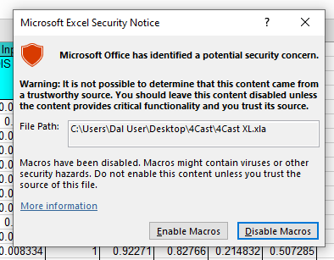

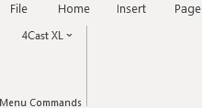
Excel add in for neural networks (4XL)
How to load the add in to the worksheet
Open Excel File Real_Estate_New.xlsx
Minimize the file view
Click on the 4XL add-in
The Real_Estate_New.xslx should open with ->
Enable Macros to get ->
Click on the Add-ins link to get
Source: http://xlpert.com/software-4Cast-XL.html

Slide 17
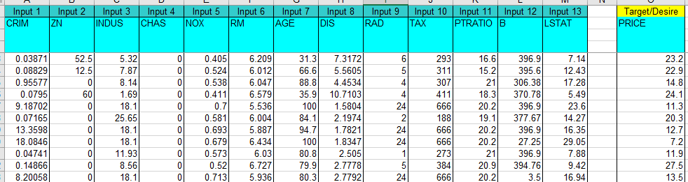
Real Estate Forecasting : Task 1
Examine the raw input in sheet ‘Raw Data’
Next – Normalize the data
Create new sheet called ‘Transpose Data’.
Copy all columns to that sheet
Normalize using the scaling option.
Source: http://xlpert.com/software-4Cast-XL.html

Slide 18
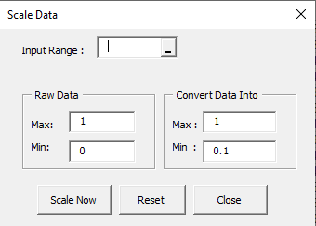
Real Estate Forecasting : Task 1 contd.
Select appropriate range in the dialog box for each column.
Clicking on the max will bring in the max and min.
View Normalized Data
See the max and min at the end of column.
Which 2 columns did not need normalization?
Source: http://xlpert.com/software-4Cast-XL.html

Slide 19

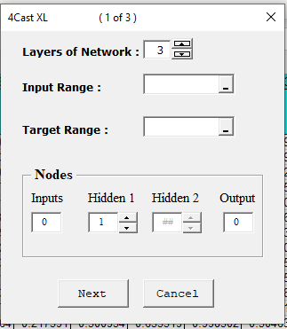
Real Estate Forecasting : Task 2
Create the network
Choose the create network menu item
Choose the input and target ranges
Choose network configuration
Layer = 3
Nodes in input = ?, in hidden = 7, in output = 1
Partition the dataset
One row for forecasting
From the rest
70% training
30% testing
Source: http://xlpert.com/software-4Cast-XL.html

Slide 20
Real Estate Forecasting : Task 2 contd.
What is the dimensionality?
Can you calculate the number of weights?
Source: http://www.xlpert.com/software-4Cast-XL.html

Slide 21
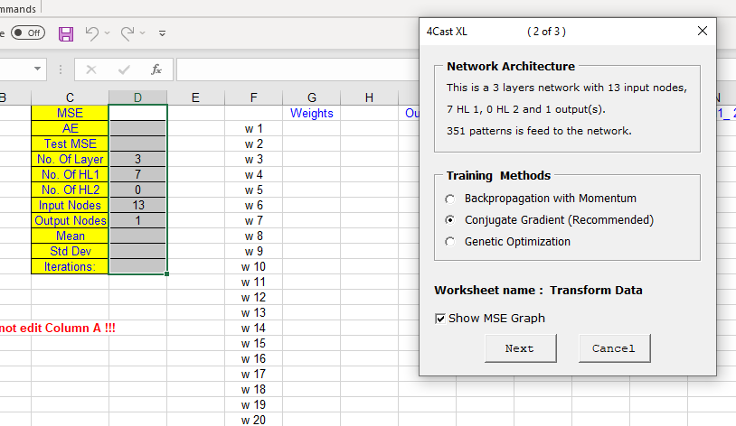
Real Estate Forecasting : Task 2 contd.
Create the network
On clicking Next see output as below
Choose the training method
Click to create error graph
Source: http://xlpert.com/software-4Cast-XL.html

Slide 22
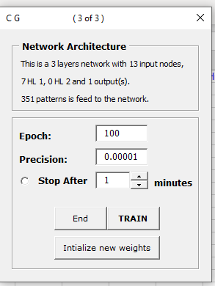
Real Estate Forecasting : Task 3
Train the network
Select value for epoch
Select precision
Select run time
Initialize weights
Source: http://xlpert.com/software-4Cast-XL.html

Slide 23
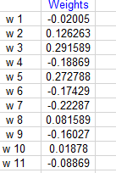

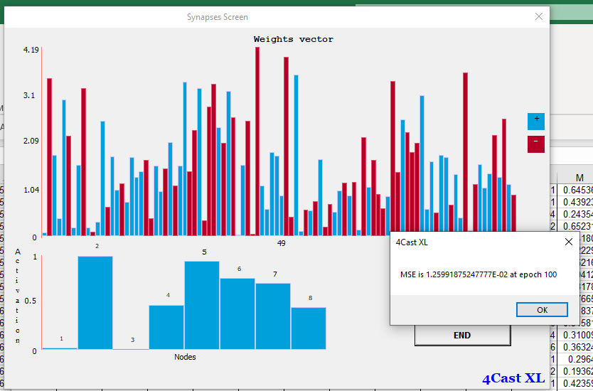
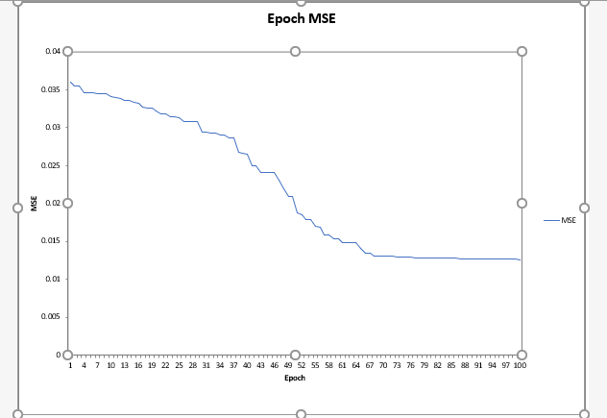
Real Estate Forecasting : Task 3 contd.
Train the network
Confirm weights have been initialized
Start Training
Check training progression
Check error after the epoch specified.
Check the MSE graph
Source: http://xlpert.com/software-4Cast-XL.html

Slide 24
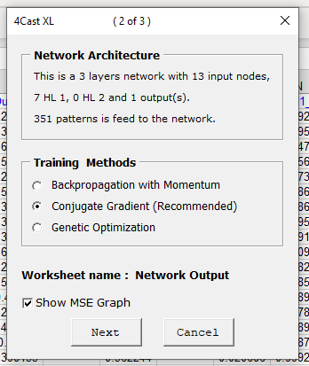
Real Estate Forecasting : Task 3 contd.
Retrain the network if need be
Use the load network option
Continue as before
Source: http://xlpert.com/software-4Cast-XL.html

Slide 25
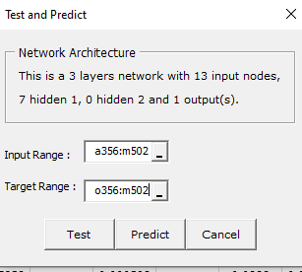
Real Estate Forecasting : Task 4.
Test the network
Use the Test or Predict option
Put in the range for test data
Click on Test
Source: http://xlpert.com/software-4Cast-XL.html

Slide 26

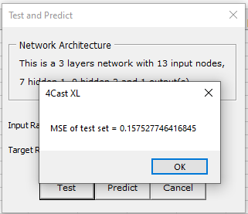
Real Estate Forecasting : Task 4 contd.
Examine Results
See the error value
Confirm error value
Determine whether this is acceptable
Source: http://xlpert.com/software-4Cast-XL.html

Slide 27
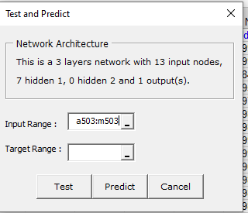
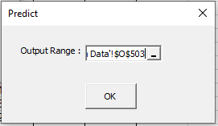
Real Estate Forecasting : Task 5
Use network for prediction
Use the Test or Predict option
Put in the range for data to predict
Keep the target range blank
Click on Predict
Put in the output range.
Source: http://xlpert.com/software-4Cast-XL.html

Slide 28

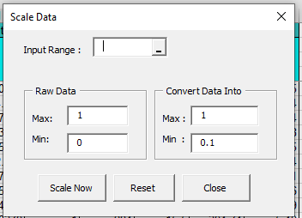
Real Estate Forecasting : Task 5 contd.
See results of prediction.
See prediction level
See if confidence level is acceptable
Un-scale results
Open Scale Data menu
Choose result to convert in input range
In Raw Data – Max = 1 and Min = 0.1
In Convert Data – Max and Min from column
Source: http://xlpert.com/software-4Cast-XL.html

Slide 29
Session summary -------------------------------------------------------------
Network design is based on
Type or class of problems
Training and selection errors
Domain knowledge
Finding input/output correlation
Iterative approach

Slide 30
References -------------------------------------------------------------
https://www.crn.com/
https://www.neuraldesigner.com/
https://en.wikipedia.org
http://xlpert.com/software-4Cast-XL.html

Slide 31
Topics for next session
Neural Networks – Concepts and Practical examples

Slide 32
End of Session ------------------------------------------------------------------ Questions

